Slide 1
Initiate git and gradle
on Eclipse

Slide 2
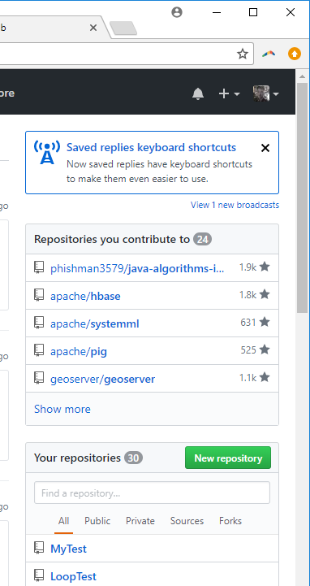
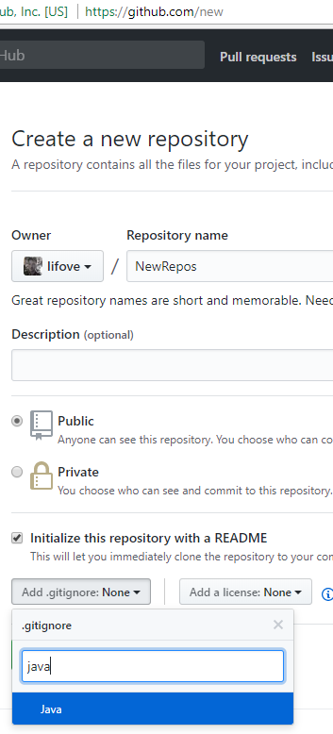
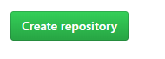
Create a remote git repository in GitHub
(2) Put repository name based on our lab and HW.
(3) Check this option
(1)
(3) Set .gitignore for java
(4) Click this button

Slide 3
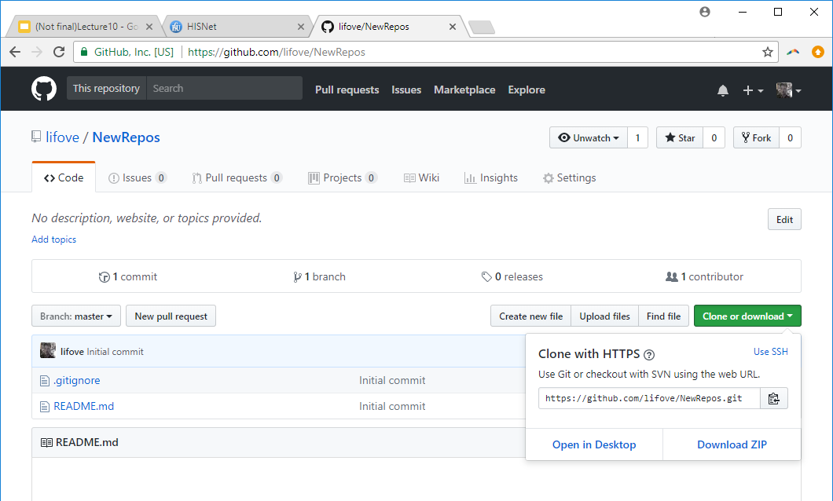
Clone the remote git to the local git (1)
(1) Copy the remote git repository address

Slide 4
Clone the remote git to the local git (2)
C:\users\yourname> cd \ // Move to the root directory
C:\> mkdir git // You need to do this only once! Make a git directory where we will have multiple project
// directories:
C:\> cd git // Move to the git repository
C:\git\> git clone https://github.com/[YOUR]/[ADDR].git // git clone in the git root directory and put the address.
Cloning into '[YOUR REMOTE GIT NAME]'...
remote: Counting objects: 4, done.
remote: Compressing objects: 100% (3/3), done.
remote: Total 4 (delta 0), reused 0 (delta 0), pack-reused 0
Unpacking objects: 100% (4/4), done.
C:\git\> dir // check your project directory is created in your directory now
[YOUR REMOTE GIT NAME]
C:\git\> cd [YOUR REMOTE GIT NAME] // Move to your project directory and init gradle
C:\git\[YOUR REMOTE GIT NAME]> gradle init --type java-library
BUILD SUCCESSFUL in 1s
2 actionable tasks: 2 executed
C:\git\[YOUR REMOTE GIT NAME]>

Slide 5
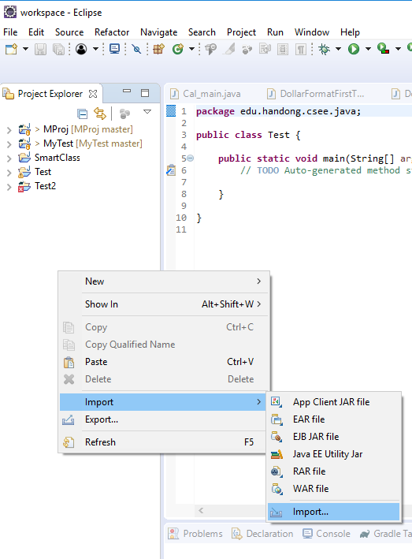
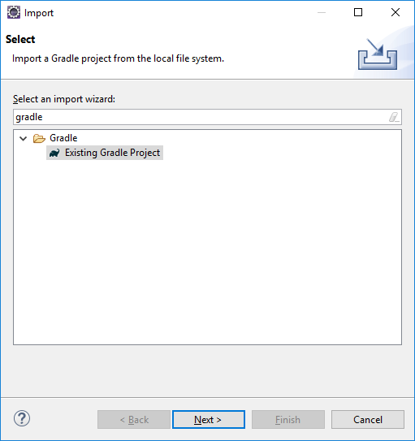
Import your gradle project into Eclipse (1)
(1) Popup → Import → Import
(2) Next → Next

Slide 6
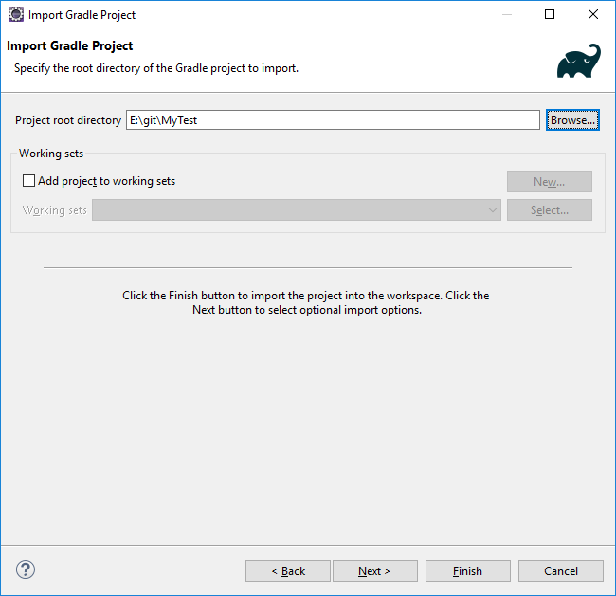
Import your gradle project into Eclipse (2)
(1) Browser and choose your project directory in C:\git\[YOUR REMOTE GIT NAME].
(2) Next → Next
(3) Finish (If you can't cliks "Finish", check if you installed Gradle-plugin in Eclipse)

Slide 7
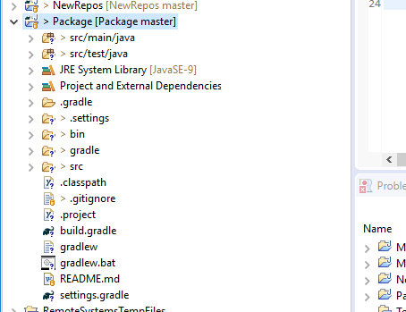
"Add to Index" for all directories and files with "?"
(1) Popup menu on a directory or file with "?" icon → Team → Add to Index
Do not add
and Ignore (Popup → Team → Ignore)
.settings
bin
.classpath
.project

Slide 8
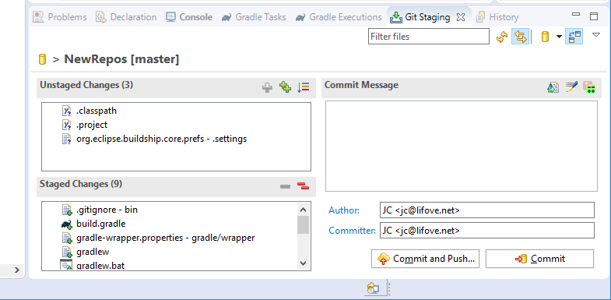
Commit and push the changes
Popup menu on the project name in Eclipse → Team → Commit
Put the commit message: "Initial commit" (You can put any message you want)
Then, Press Commit and Push! (You may need to login with your Github account)
Commit for gradle setting

Slide 9
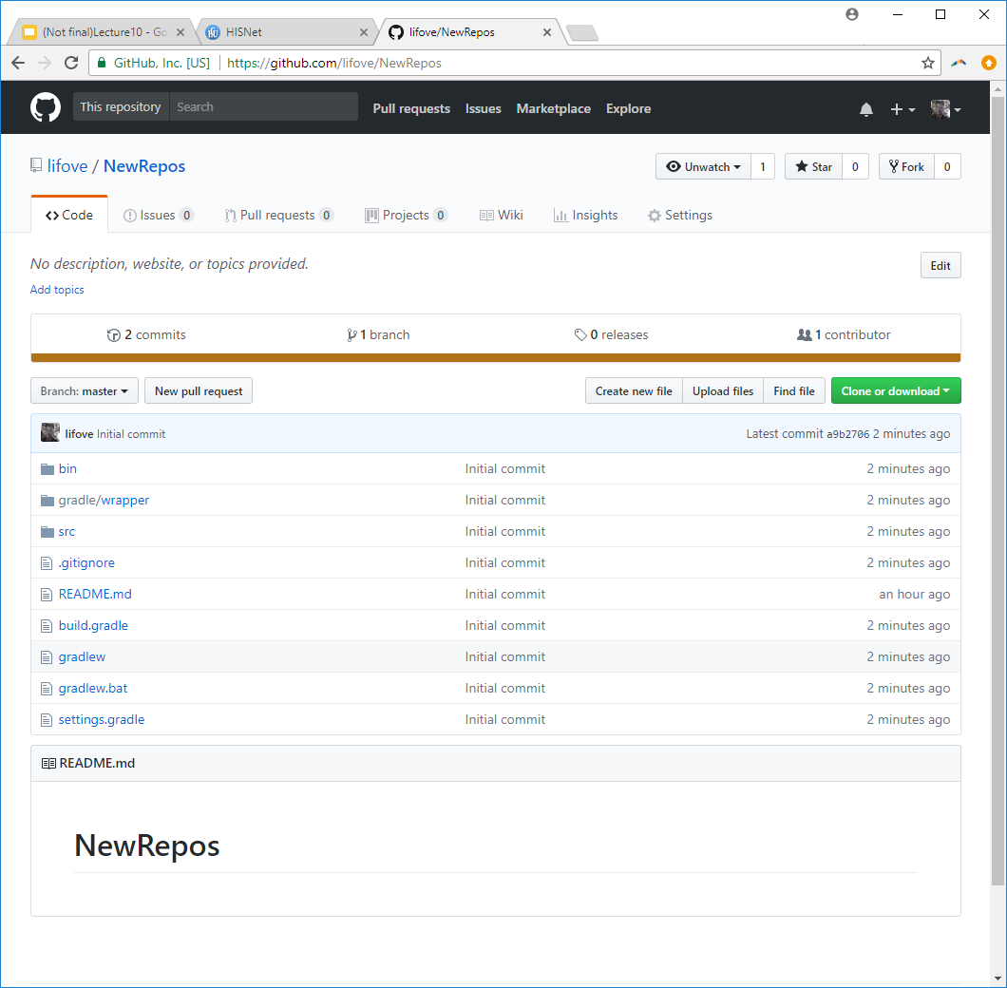
Check in your GitHub
Click this tab to see the commit history

Slide 10
Now all set!!!
Create your packages and classes under the "src/main/java" directory in Eclipse!!
And commit and push frequently
Do not forget to do "Add to Index" first whenever you created new Java files!
In case you have a problem, delete a repository that has a problem. Then carefully do all steps again.
Delete a GitHub Repository
In GitHub repository, go to Settings menu and there is a "Delete this repository" button in the bottom
Delete your local repository if the directory is not deleted from the Eclipse
Close Eclipse and CMD
Run File Explorer and remove the directory in C:\git
Delete a project in Eclipse
Open popup menu on the project name in Eclipse → Delete → Check the option, "Delete Project contents on dis" → OK

